Slide 1



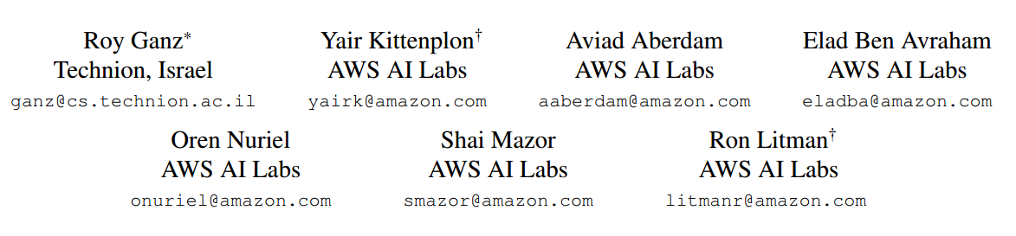
Question Aware Vision Transformer for Multimodal Reasoning
汇报人：吴宗錝
CVPR（2024）

Slide 2

Contents.
01
02
Main work
Contribution
目录
03
04
Method
Experiment
05
Conclusion
知行合一、经世致用
Central South University

Slide 3
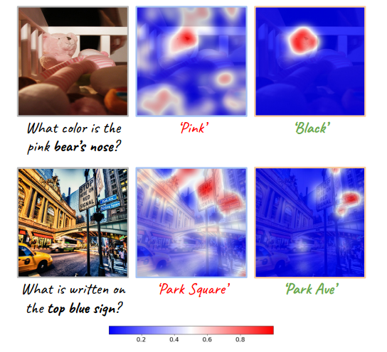
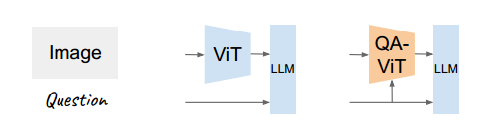

Main work
01
The vision encoding process remains decoupled from user queries, often in the form of image-related questions. the resulting visual features may not be optimally attuned to the query-specific elements of the image.
To address this, this paper introduce QA-ViT, a Question Aware Vision Transformer approach for multimodal reasoning, which embeds question awareness directly within the vision encoder.
Notes:
视觉编码过程仍然与用户查询脱钩，通常以与图像相关的问题的形式出现。因此，生成的视觉特征可能无法最佳地适应图像的查询特定元素。

Slide 4
Contribution
02
We identify an overlooked suboptimality in the paradigm of vision-language modeling stemming from the lack of instruction-aware image encoding.
We introduce QA-ViT, a model-agnostic method that enables existing vision encoders to be conditioned on textual prompts or questions.
Notes:
我们发现视觉语言建模范式中存在被忽视的次优性，这是由于缺乏指令感知图像编码造成的。
我们引入了 QA-ViT，这是一种与模型无关的方法，可以使现有的视觉编码器根据文本提示或问题进行调整。

Slide 5
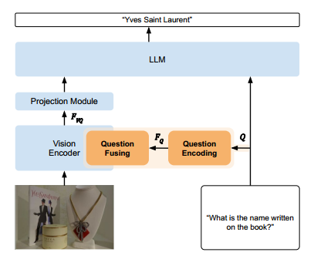
Method
03
1. overview of QA-ViT
1.Question Encoding:
The question, denoted as Q, is fed into a “Question Encoding” module, which processes and projects the textual prompt.
2.Question Fusing:
The textual encoded features are integrated inside a frozen vision model via “Question Fusing” module.
Notes:
实现过程很简单，就是通过将问题 Q 编码为特征 FQ 来实现的，这些特征被融合到视觉编码器中，从而产生问题感知的视觉特征 FV Q。
首先，将问题（表示为 Q）输入“问题编码”模块，该模块处理并投射文本提示
随后，将文本编码特征（表示为 FQ）通过“问题融合”模块集成到冻结视觉模型中，生成文本感知视觉特征 FV Q。

Slide 6
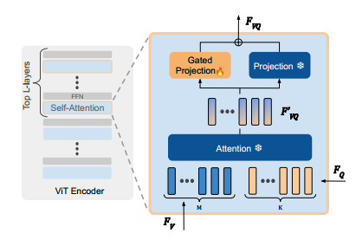
Method
03
2. Question Fusing
The M visual features from the previous layer FV , are concatenated with K textual features FQ and fed into the frozen self-attention mechanism to obtain M text-attended visual representations F′VQ.
General scheme
of the ViT encoder.
Notes:
左图：ViT 编码器的总体方案。右图：放大到顶部 L 个自注意力层之一中的融合机制。来自上一层 FV 的 M 个视觉特征与 K 个文本特征 FQ 连接并输入到冻结的自注意力机制中以获得 M 个文本关注的视觉表示 F ′ V Q。接下来，并行门控投影获得 FV Q 的问题感知视觉特征。

Slide 7
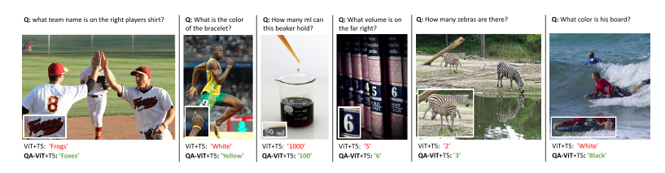
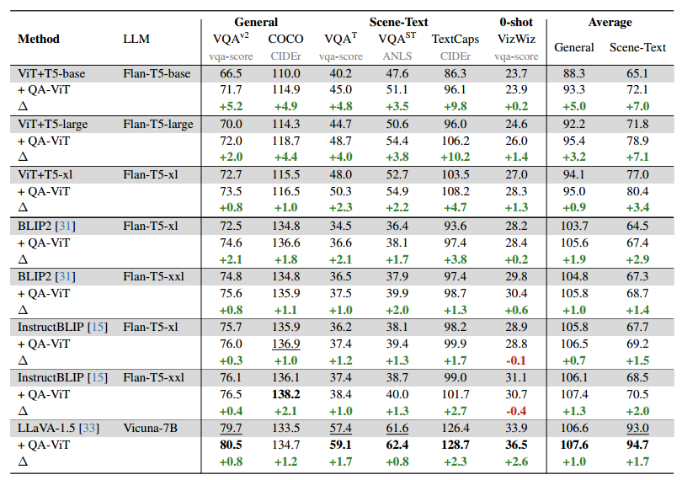
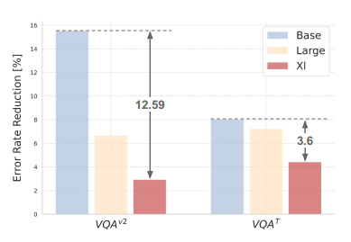




















Experiment
04

Slide 8
Conclusion
05

Slide 9

THANKS

